Slide 1
McSOC:
A scripted 'SOC in a BOX' network deployment
Ronald Broberg
December 2016

Slide 2
McSOC: Executive Summary
Create a redeployable network architecture that can
demonstrate SOC capabilities
provide a platform to develop SOC solutions
Be delivered as a training environment

Slide 3
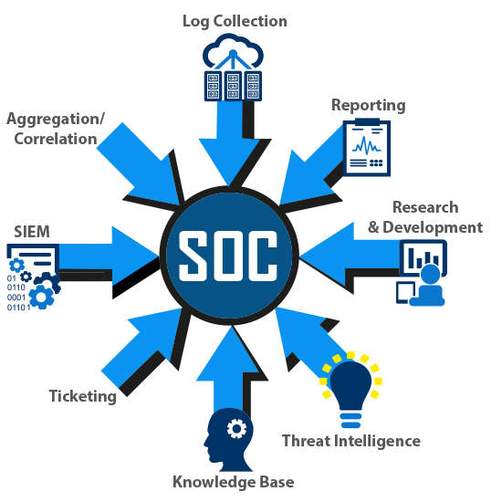
McSOC: Capabilities
https://www.nuspire.com/technologies/soc/

Slide 4
McSOC: High Level Features
Infrastructure as Code
Network Deployment and Configuration is Scripted
Self-Validation
Continuous Monitoring
Automated Testing
Capabilities Definition
Capabilities Documentation bundle
Use Case Development
Use Cases bundled

Slide 5
McSOC: Technology Guide
Open Source Components
Minimize License Issues
Maximize Re-usability
Deployable to Multiple Visualization Hosts
Develop on single server
Deploy to Amazon AWS or Vmware
Automated Testing
Deployed Project should be able to self-validate

Slide 6
McSOC: Constraints and Limitations
Resource Constraints
Not a scalable architecture
The NAT interface links nodes undesirably
Limits use a CyberRange model
Lack of Microsoft Components
Enterprise Servers Lack Key Microsoft Services
Active Directory
Exchange
Enterprise Workstation Are Not Microsoft
Unrealistic reflection of Enterprise

Slide 7
Infrastructure Design

Slide 8
McSOC: Network Layout
Internet
DMZ
SOC
ENT SVR
DEV SVR
ENT WKS
DEV WKS

Slide 9
McSOC: Infrastructure Layout
Internet
DNS
WEB
EMAIL
Web Client
Email Client
Network Monitor
SIEM
Log Collection
Event Analysis
Vuln Mgmt
Ticketing
Knowledge Base
Theat Intel
DNS
EMAIL Filter
WEB Proxy
URL Filter
NAT
VPN
DMZ
SOC
ENT SVR
DEV SVR
Active Directory
DNS
EMAIL
WEB
FILE
ENT WKS
AD Client
Web Client
Email Client
DEV WKS

Slide 10

McSOC : WAN : TEST
Test Services
DNSMASQ
NGINX Web Server
Email Server
MTA
MDA
Email Client
Web Mail
CentOS 7

Slide 11
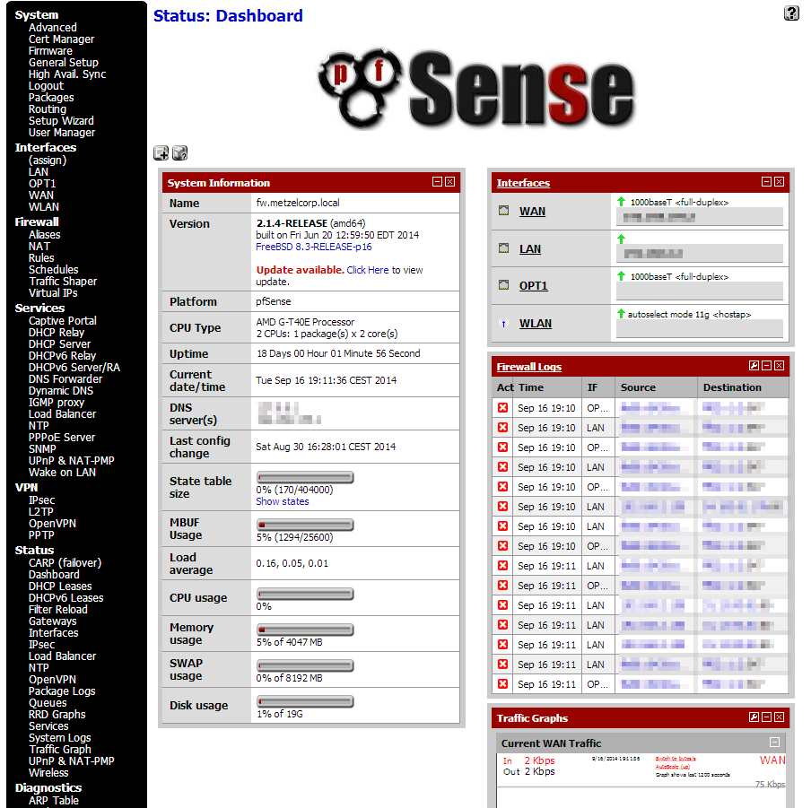
McSOC: - : ROUTERS
pfSense
Firewall
Routing
SNMP
FreeBSD 10

Slide 12
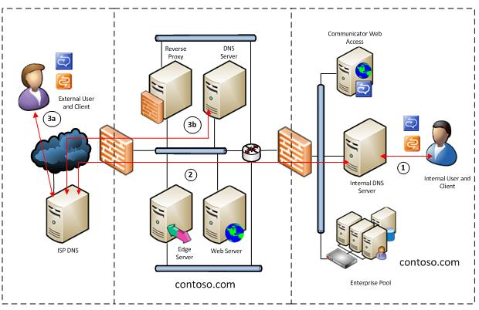
McSOC : DMZ : DNS
DMZ DNS
DNSMASQ
CentOS 7
https://www.ixsystems.com/blog/an-email-gateway-with-freebsd-to-prevent-malware-and-undesirable-messages/

Slide 13
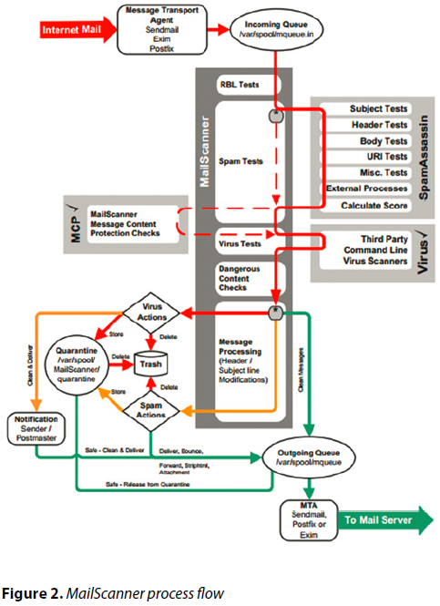
McSOC : DMZ : MAIL
Mail Gateway
Postfix
MailScanner
SpamAssassin
ClamAV
CentOS 7
https://www.ixsystems.com/blog/an-email-gateway-with-freebsd-to-prevent-malware-and-undesirable-messages/

Slide 14
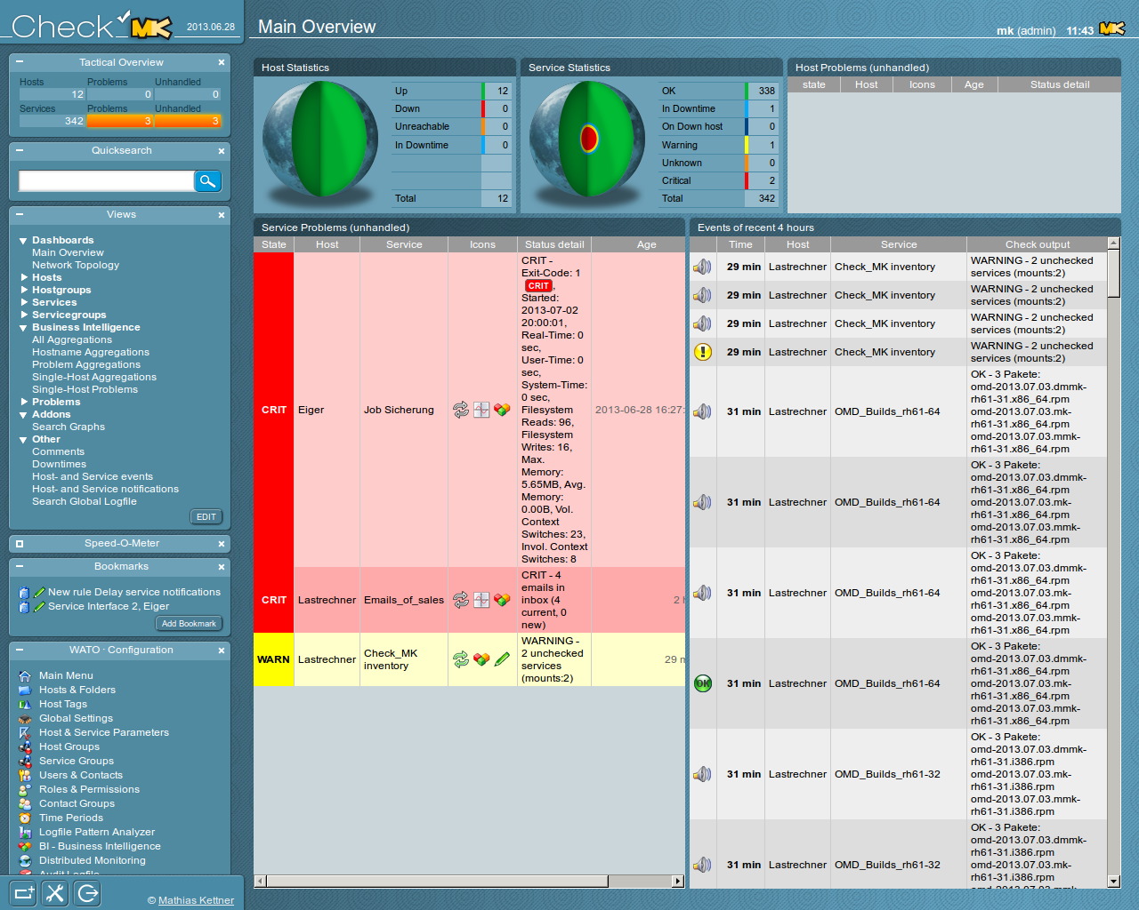
McSOC: SOC : NAGIOS
Network Monitor
Check_MK
Nagios Variant
Liveevent Service
Ubuntu 16 Xenial

Slide 15
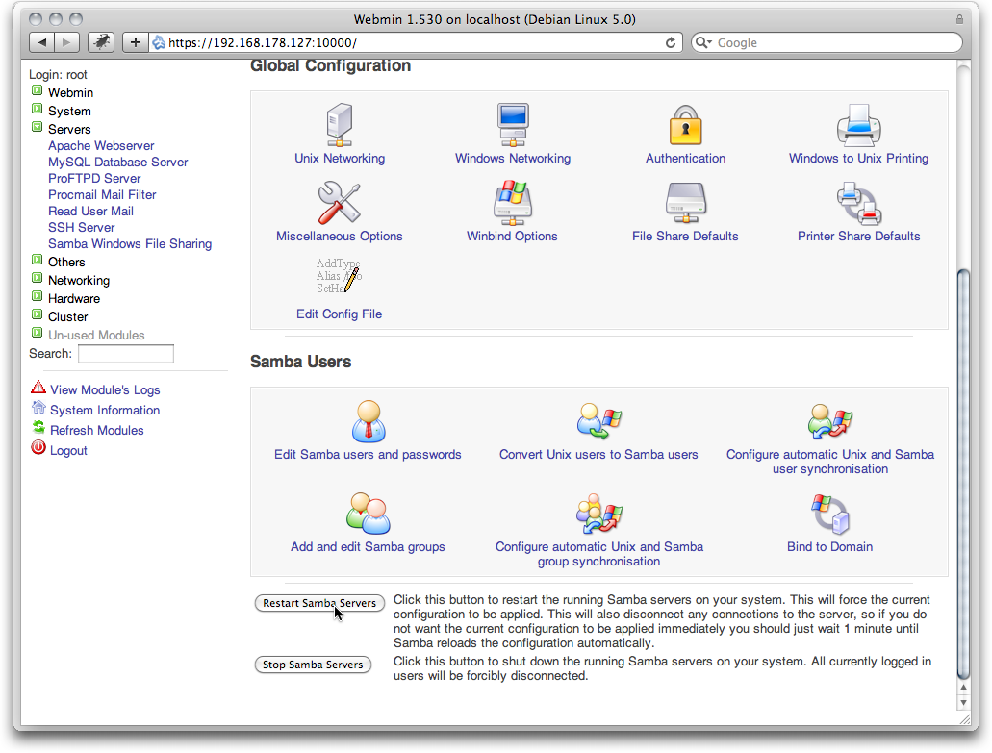
McSOC: ENTSVR : DC1
Domain Controller
Samba4 Authentication
Mail Server
MTA: PostFix
MDA: Dovecot
DNS Server
Bind9
CentOS 7

Slide 16
McSOC: ENTSVR : MAIL
Mail Server
MTA: PostFix
MDA: Dovecot
AD/LDAP Authentication
CentOS 7

Slide 17
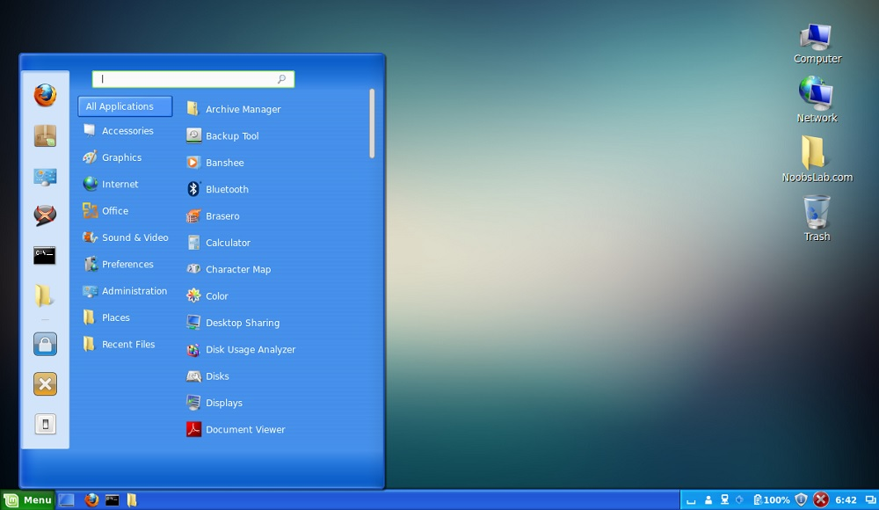
McSOC: ENTWKS : WKS101
Domain Client
Samba4 Authentication
Mail Client
Mozilla Thunderbird
Web Browser
Mozilla Firefox
Mint Linux 14
Win 7 Look and Feel

Slide 18
Network Data Flow

Slide 19
McSOC: Inbound Email Flow
Postfix holds the mail upon receipt.
MailScanner scans the email in queue.
SpamAssassin
ClamAV
MailScanner re-queues the email and hands it over back to Postfix.
Postfix processes the email as necessary and delivers the mail to recipient.

